Slide 1
Big Data, AI, Machine Learning, Investment and Algo Trading
Ken Liu

Slide 2
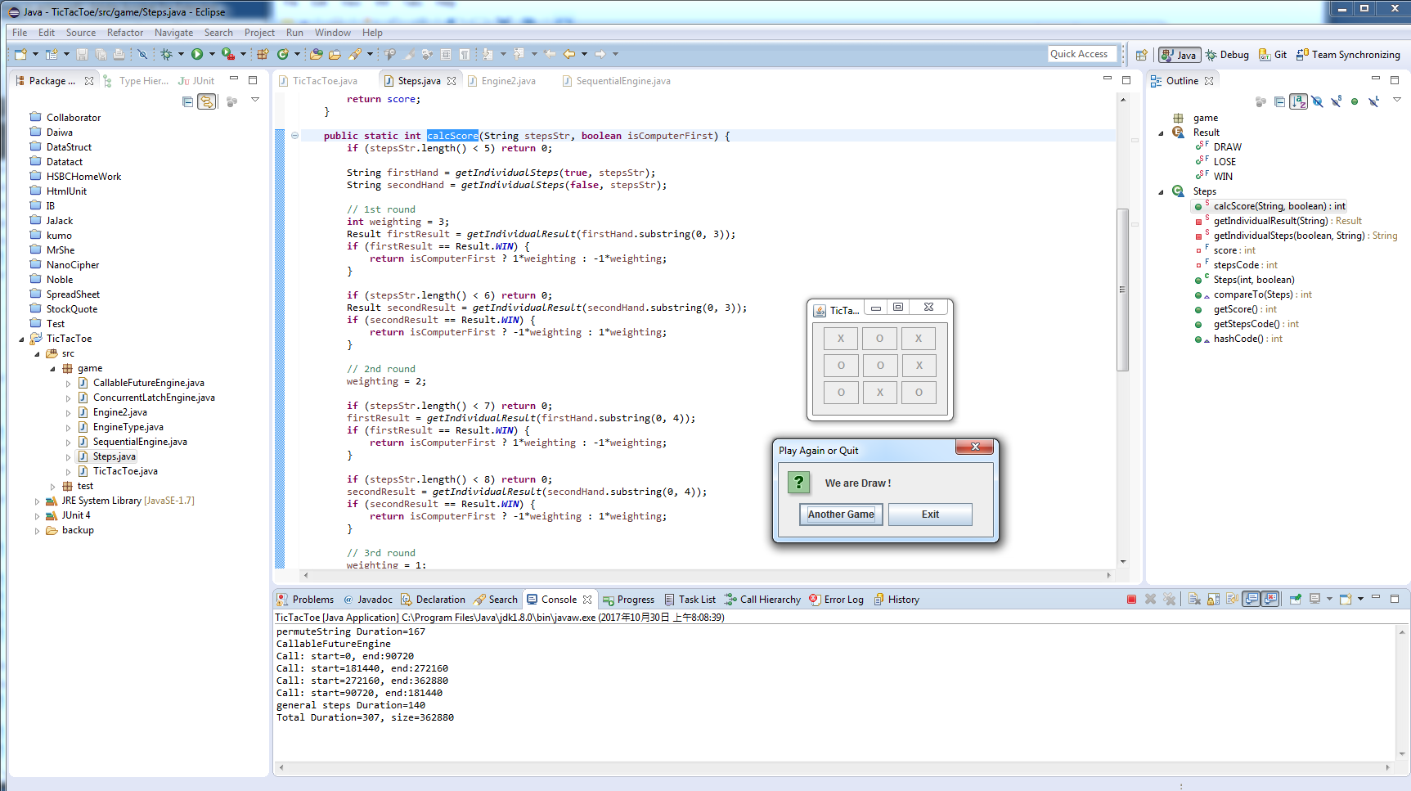
Introduction to AI - First AI Boom
Tick Tac Toe Example

Slide 3
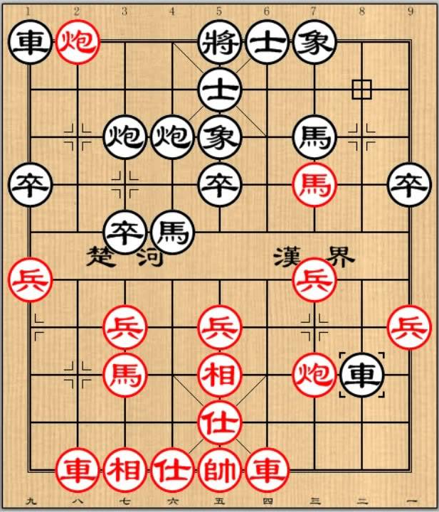

Introduction to AI - First AI Boom
Do I need to be a good chess player to write a good chess game?
No need. Computer just evaluate the game tree. Advanced Level means evaluating more level at each steps. Moreover, towards the end game, computer becomes faster (as fewer steps to evaluate) while human players tends to spend more time to think of each of steps carefully.

Slide 4
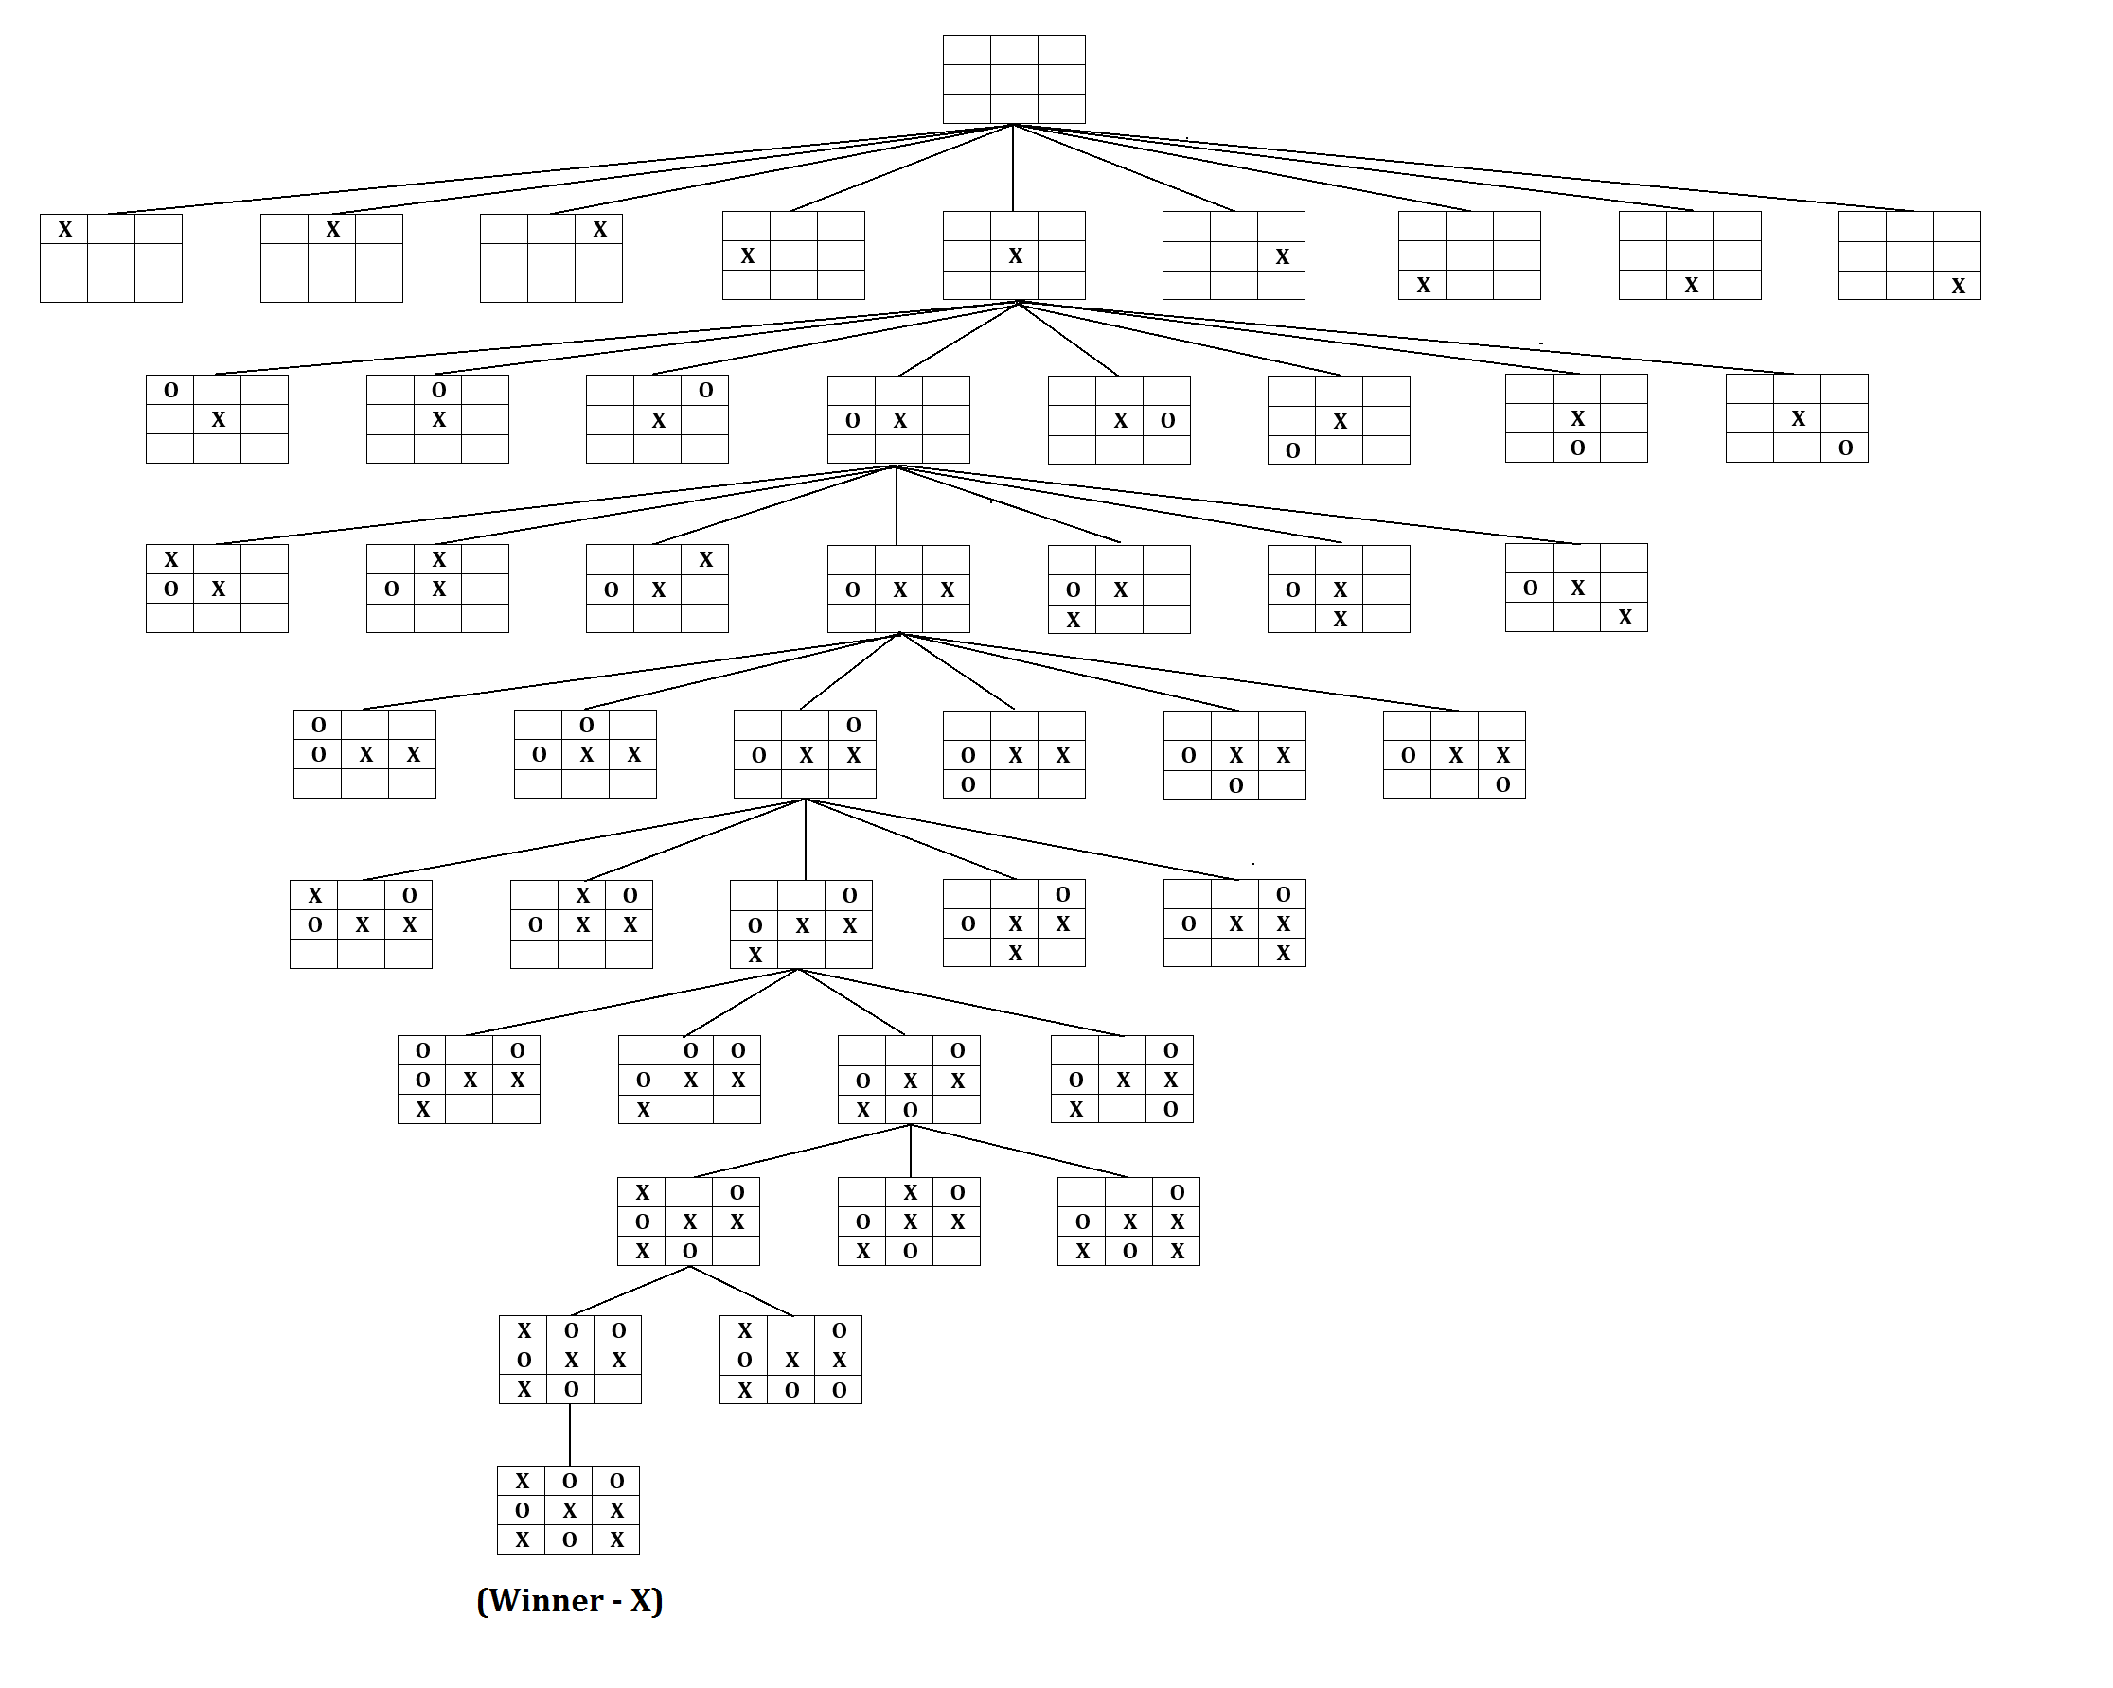
Introduction to AI - First AI Boom
Game Search Tree

Slide 5
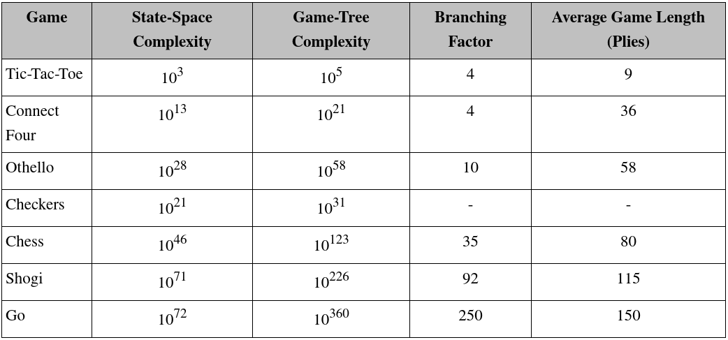
Introduction to AI - First AI Boom
Key Points: State-Space (Complete Information and deterministic), Search Tree (Brute-force, Heuristic, Adversarial), Goal (Score, Weighting)

Slide 6
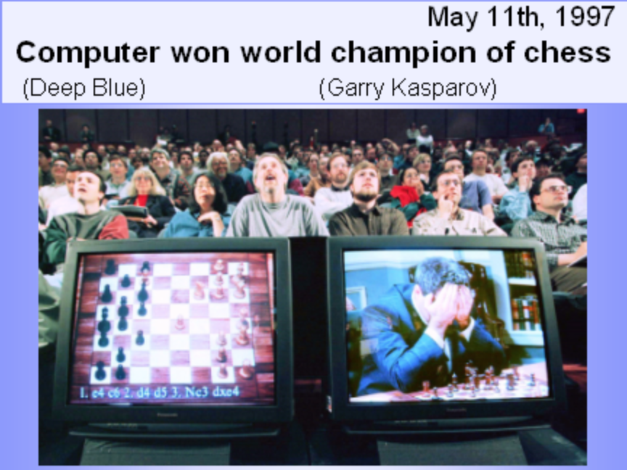
Introduction to AI - First AI Boom
Frame Problem
A machine can achieve great success in the field of Chess because the searching space is limited (set in a certain frame) in advance
Machine follow detailed rules set by a human. It is far from achieving actual AI. Therefore, the first AI boom cooled down rapidly with disappointment.
1997 News – IBM Deep Blue beats World Chess Champion Garry Kasparov

Slide 7
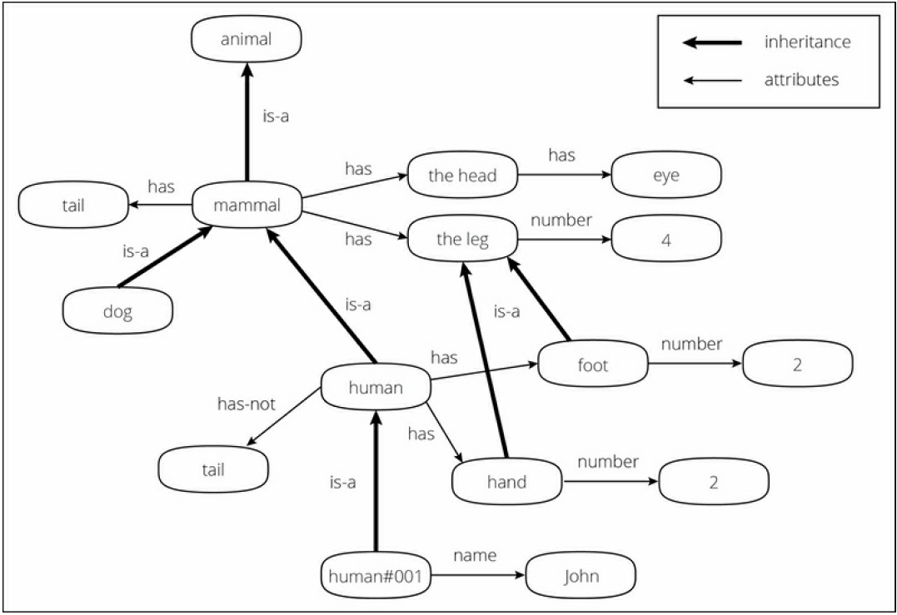
Introduction to AI - Second AI Boom
The second AI boom came in the 1980s.
Knowledge Representation (KR) and Expert system was booming and intended to describe knowledge that a machine could easily understand

Slide 8
Introduction to AI - Second AI Boom
Problems and Limitations
Inputting all real-world knowledge requires an almost infinite amount of work (Back then, Internet and Web were not existed yet)
Machine does not understands the actual meaning of the knowledge. Even if the knowledge is structured and systemized, a machine understands it as a mark and never understands the concept. Machine just compare the data and assume meaning based on the dictionary.
For example, if you know the concept of "apple" and "green" and are taught "green apple = apple + green", then you can understand that "a green apple is a green colored apple" at first sight, whereas a machine can't. This is called the symbol grounding problem and is considered one of the biggest problems in the AI field, as well as the frame problem.

Slide 9
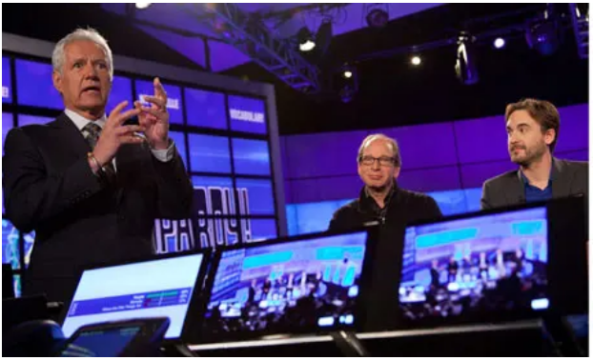
Introduction to AI - Second AI Boom
Today the Internet is commonly used and we can obtain enormous amounts of open data from the Web. (Has Google search become Expert System?)
Cyc build an inference engine based on the database of this knowledge, called knowledge base.
IBM computer Watson wins Jeopardy clash

Slide 10
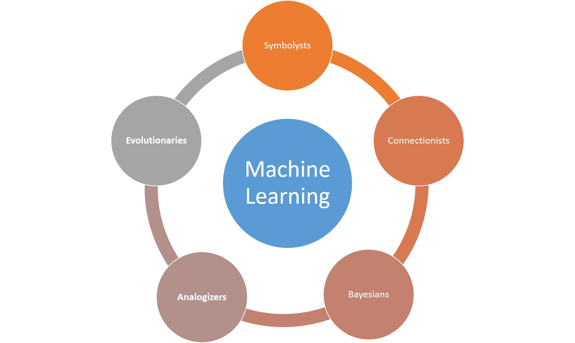
Introduction to AI – Approaches

Slide 11
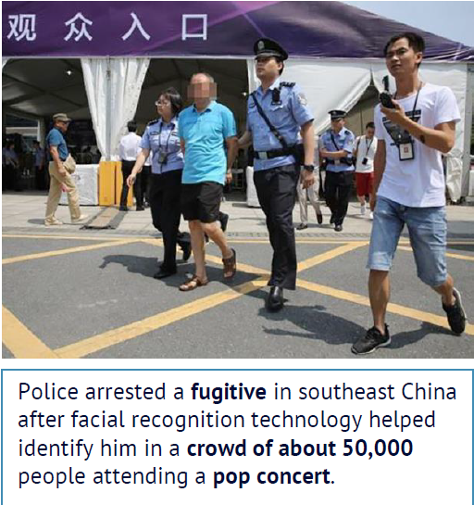
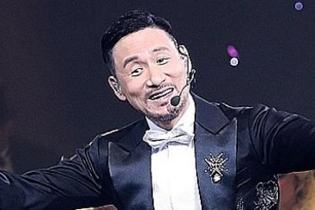
Introduction to AI - Third AI Boom (Now)
Machine Learning: a branch of AI and the key driver is (big) data from Internet, Mobile and IoT (Internet of Things which are sensors, smart devices etc.)
Example: 1.3 billions of faces in China, how can tell a computer to recognize a person?
# pseudo code
Color in {brown, yellow, black}
Has {hair, eye * 2, nose, mouth,
ear * 2 ……}
Eye: {black, white, brown ……..}
……………….
https://www.npr.org/sections/therecord/2018/05/23/613692526/thanks-to-ai-a-3rd-person-is-arrested-following-a-pop-superstars-concert

Slide 12
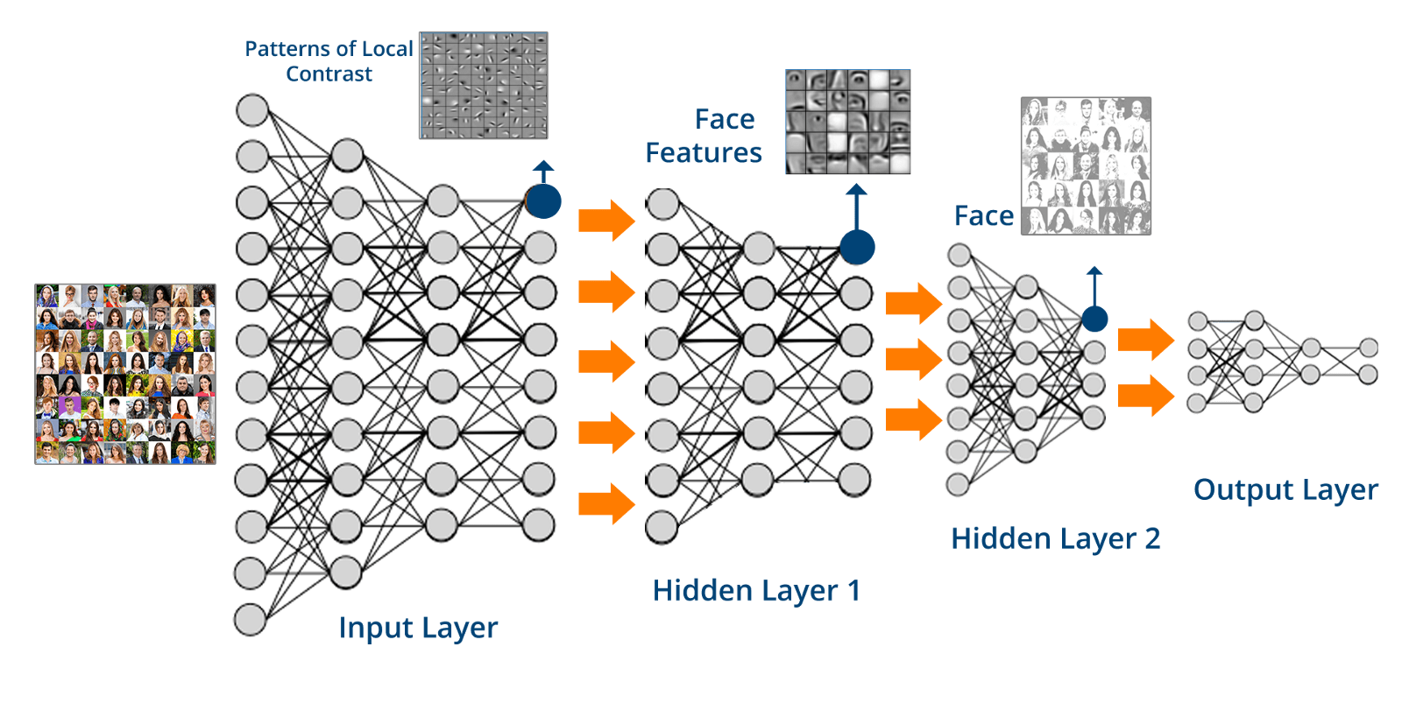
Machine Learning - Data
Learn from data rather than explicitly program the logic: let the computer see many examples (face, name) and learn how to represent it in a Deep Neural Network (brain-like structure)

Slide 13
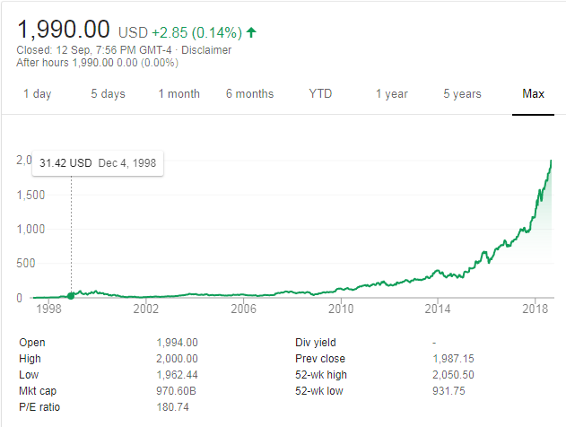

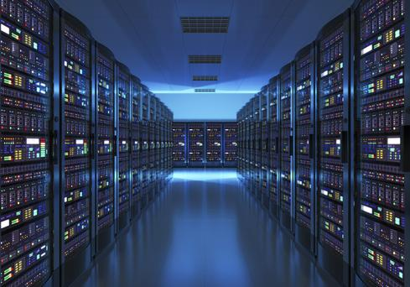
Machine Learning - Cloud
Commodities Infra (Cloud) : rent super computers (from AWS, Google Cloud etc.) for few hours to train the machine learning model. (Training vs Predicting time)
Notes:
Long nVidia is better than so many quant trades !

Slide 14
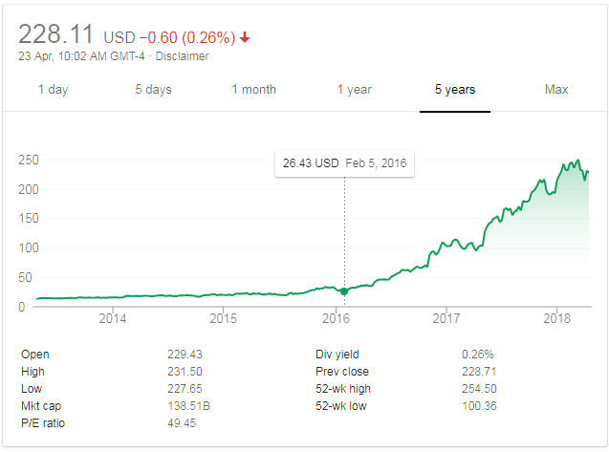

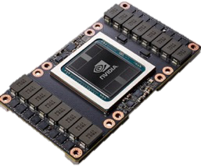
Machine Learning - GPU
Hardware Parallelization: GPU (Graphics Processing Unit) substantially improve the speed of calculation (nVidia stock price has gone up substantially)
Tesla V100 : 120 TFLOPS
One more usage: https://easyhashing.com/en/
Notes:
Long nVidia is better than so many quant trades !

Slide 15
Machine Learning - Algorithm
Algorithms: new techniques in processing data in parallel. Such as Map-Reduce which distribute the program logic to the data and combine the results.
Breakthrough: Deep Learning solve some bottlenecks previously encountered in Neural Networks and results in commercial success.
2013 Playing Atari with Deep Reinforcement Learning
2016 Alpha Go

Slide 16
Machine Learning - Community
Community and Competition: Open Source APIs and prize awards
Netflix Prize: https://en.wikipedia.org/wiki/Netflix_Prize
https://www.netflixprize.com/leaderboard.html
(open competition for the best collaborative filtering algorithm to predict user ratings for films, based on previous ratings without any other information about the users or films, i.e. without the users or the films being identified except by numbers assigned for the contest. On September 21, 2009, the grand prize of US$1,000,000 was given to the BellKor's Pragmatic Chaos team which bested Netflix's own algorithm for predicting ratings by 10.06%.)
IBM’s Watson Analytics platform is now open to everyone

Slide 17
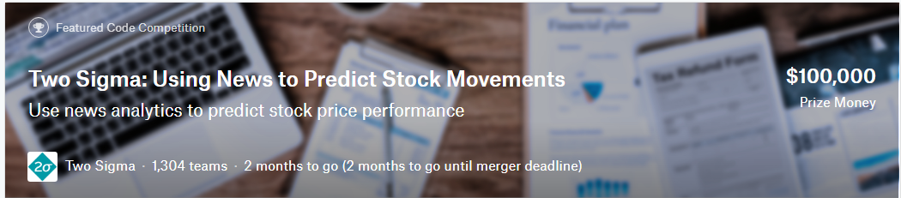
Machine Learning - Community
Kaggle Competitions: Two Sigma: Using News to Predict Stock Movements
The challenge is ingesting and interpreting the data to determine which data is useful, finding the signal in this sea of information. Two Sigma is passionate about this challenge and is excited to share it with the Kaggle community.
By analyzing news data to predict stock prices, Kagglers have a unique opportunity to advance the state of research in understanding the predictive power of the news. This power, if harnessed, could help predict financial outcomes and generate significant economic impact all over the world.
Market data provided by Intrinio.
News data provided by Thomson Reuters

Slide 18
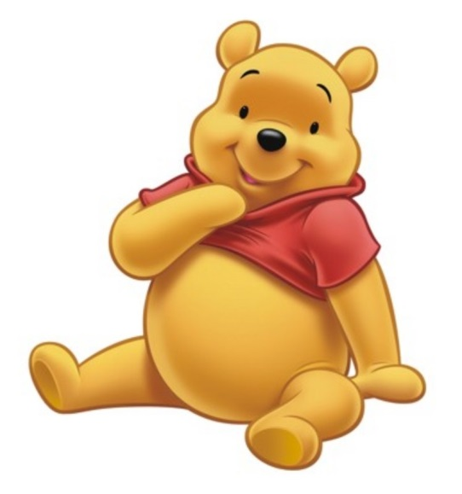
Use Cases – Face Recognition
Face recognition: Face (iPhoneX FaceId), Security Camera
http://www.telegraph.co.uk/news/2017/03/20/beijing-park-uses-face-recognition-software-wipe-toilet-paper/
How to send Winnie-the-Pooh

Slide 19

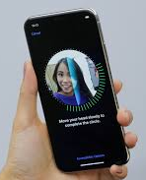
Use Cases – Face Recognition
化妝就係你落咗妝，我仲認得你，你落咗妝，我唔認得你，嗰啲叫做喬裝。
If you can still unlock FaceId, it’s called make-up, otherwise it’s a “fake-up”
上咗妝後 FaceId 仲認得叫做化妝，認唔到嘅叫做喬裝

Slide 20
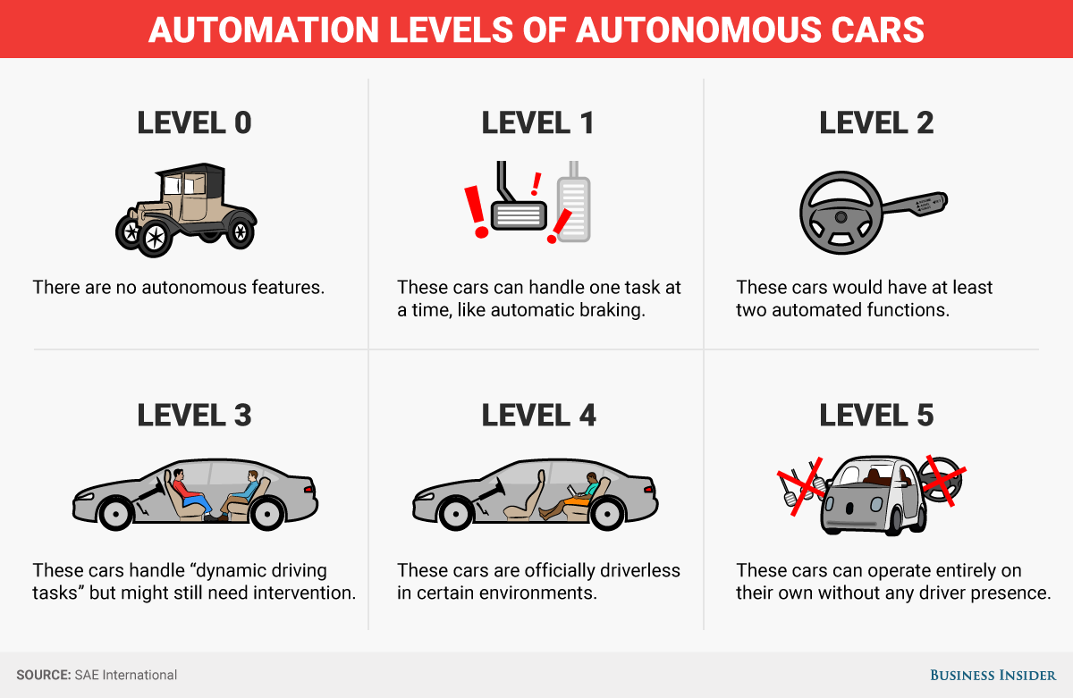
Use Cases – Self Driving Car

Slide 21
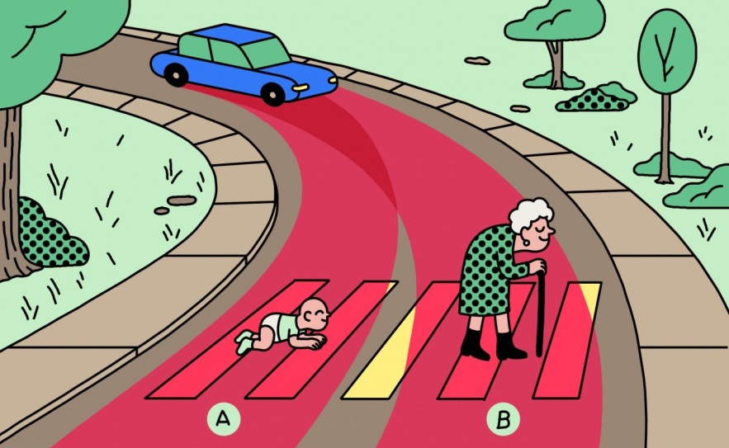
Use Cases – Self Driving Car
Challenges
Data & Algo biased:
Should a self-driving car kill the baby or the grandma?
Driverless Cars Will Have to Break the Law
Responsibility: in case of breaking the law, who should go to jail (the car owner or the car company)
Less tolerant on machine than human
2019: Fanlan bus incident
2017: Taipo road incidents

Slide 22
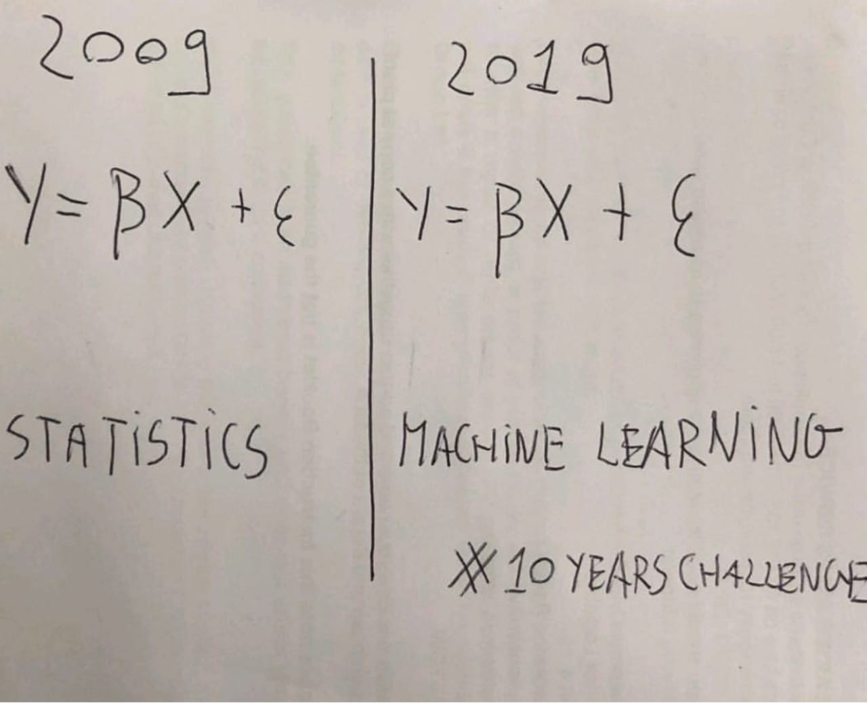
Example – Linear Regression

Slide 23
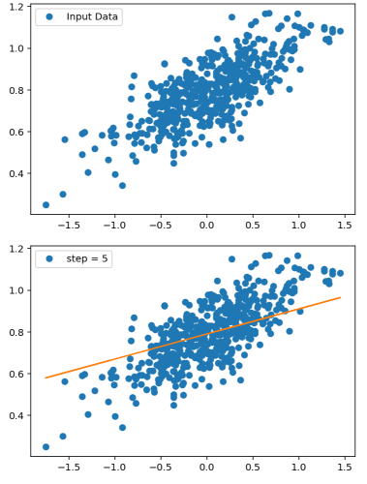
Example – Linear Regression
Learning Regression (the model)
y = ax + b
Input Data -> Output
Parameter (a, b)
Loss/Objective function
Gradient Descent
Training (no. of steps)
Code Example

Slide 24
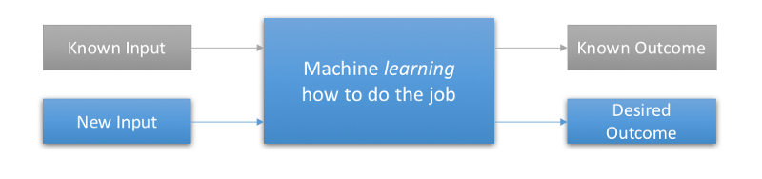
Supervised Learning
Presented with example inputs and their desired outputs (labelled dataset), given by a "teacher“. The goal is to learn a general rule that maps inputs to outputs (i.e. learn a function of g(x) = y)
The dataset commonly know as feature vectors
It requires large human efforts to manually labelled the data. Nonetheless, the internet already provide many source of labelled data: movies reviews, subtitles, tag your friend in photos, social media reactions

Slide 25
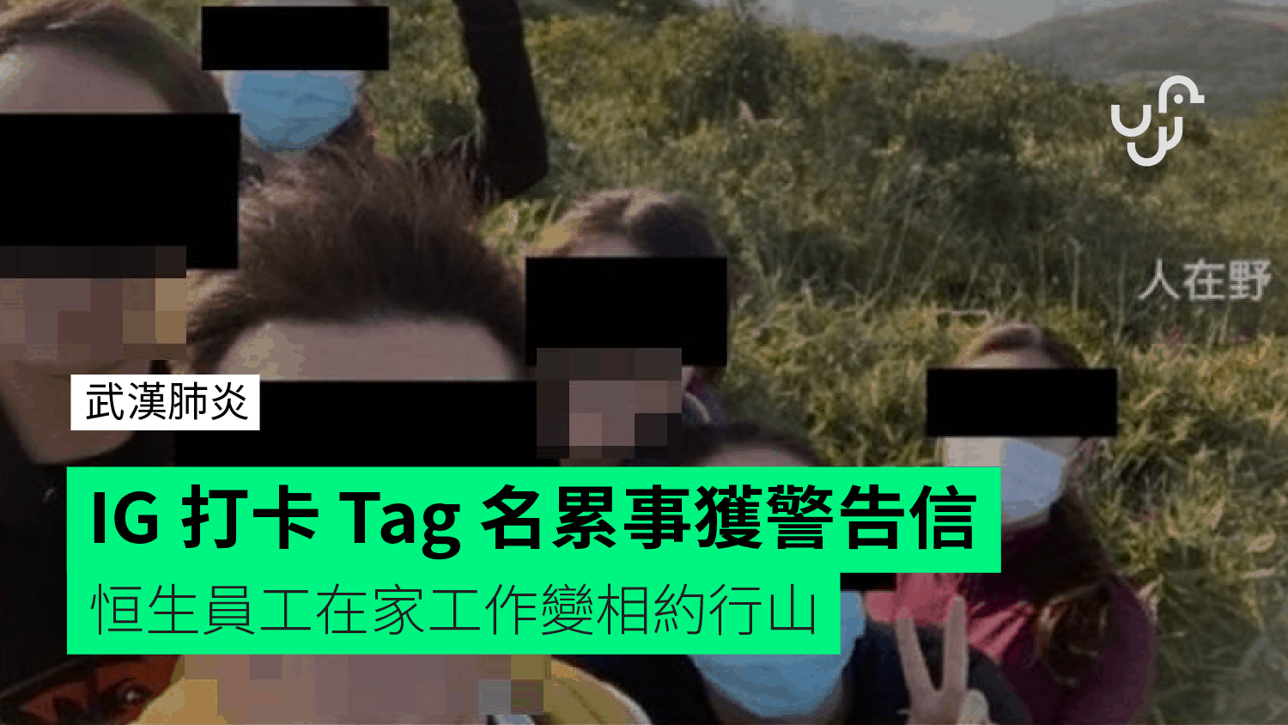
Labelled Dataset
Where to find labelled dataset?
Kaggle Dataset
Google Dataset Search
AWS Open Data
Human Data Labeler
Amazon Mechanical Turk
And…………You !
(e.g. tagged your friends in Facebook or IG)

Slide 26
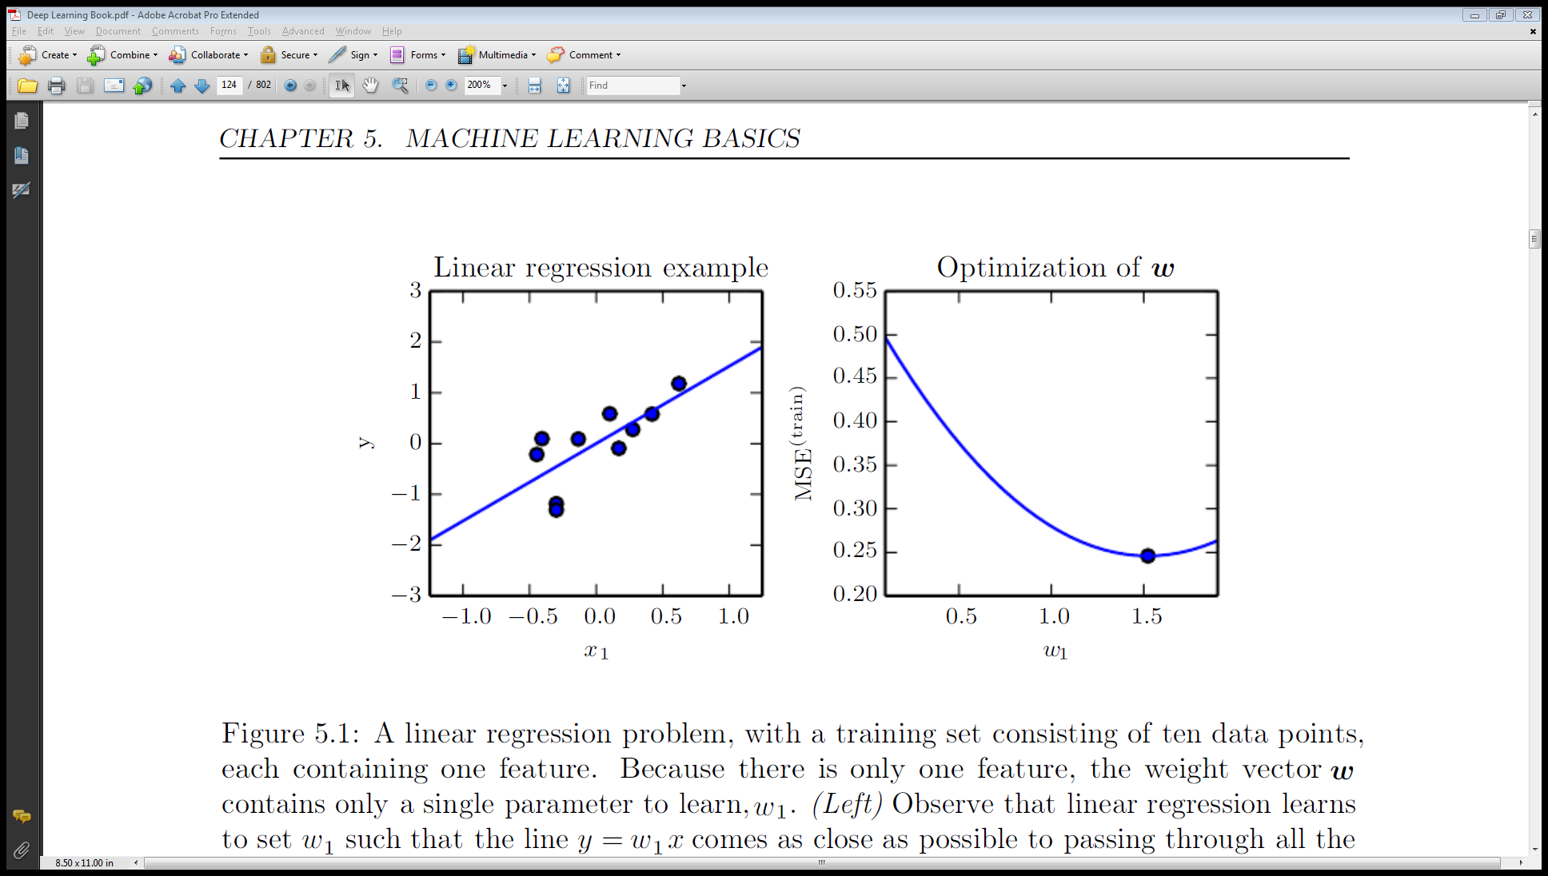
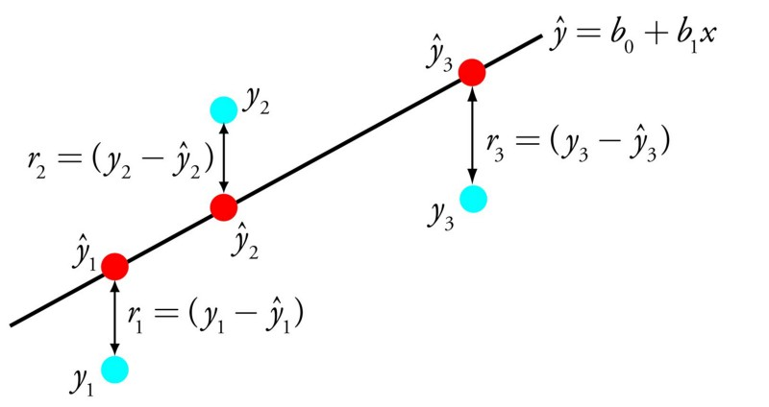
Objective function
A way to measuring the quality the model. This function, taking data and model parameters as arguments, can be evaluated to return a number. Any given problem contains some parameters which can be changed; our goal is to find values for these parameters which either maximize or minimize this number. (Similar terms: Cost function, Loss Function)

Slide 27

Gradient Descent
Gradient Descent: an optimization algorithm used to find the values of parameters (coefficients) of a function (f) that minimizes a cost function (cost).
Notes: Hyper-parameters are parameters whose values are set prior to the commencement of the learning process. By contrast, the values of other parameters are derived via training.

Slide 28
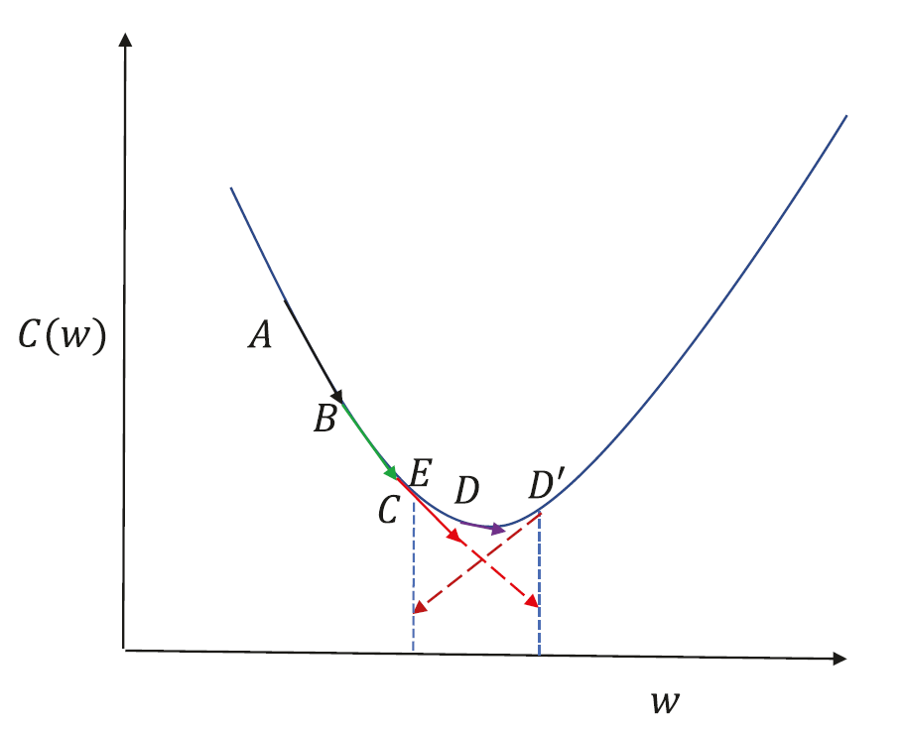
Learning Rate
Cost function between A and C is almost linear, and so gradient descent works well.
From point C, if we take a small learning rate at C, we will end up at D, which is reasonable enough since it doesn’t overshoot the point of minima.
A larger step size at C will get us to D ', which is not desirable, because it’s on the other side of the minima.
A large step size at D ' would get us to E, and if the learning rate is not reduced the algorithm tends to toggle between points on either side of the minima, leading to oscillations

Slide 29

Demo – Short Term Stock Price Prediction
Use Machine Learning to predict the short term stock price movement

Slide 30
Raw Data – Historical Tick Data
https://www.hkex.com.hk/eng/ods/historicalData.aspx
Historical Full Book - Securities Market (CSV Format) provides information on every order and trade of Main Board and GEM stocks in CSV format. File is available on a daily basis, normally at around 10:00pm.
$5,000/Month
Historical Order Book and Statistics Update - Securities Market provides intra-day order book and statistics information recorded on the HKEX's Main Board and GEM stocks in CSV format. File is available on a daily basis, normally at around 10:00pm.
$2,500/Month

Slide 31
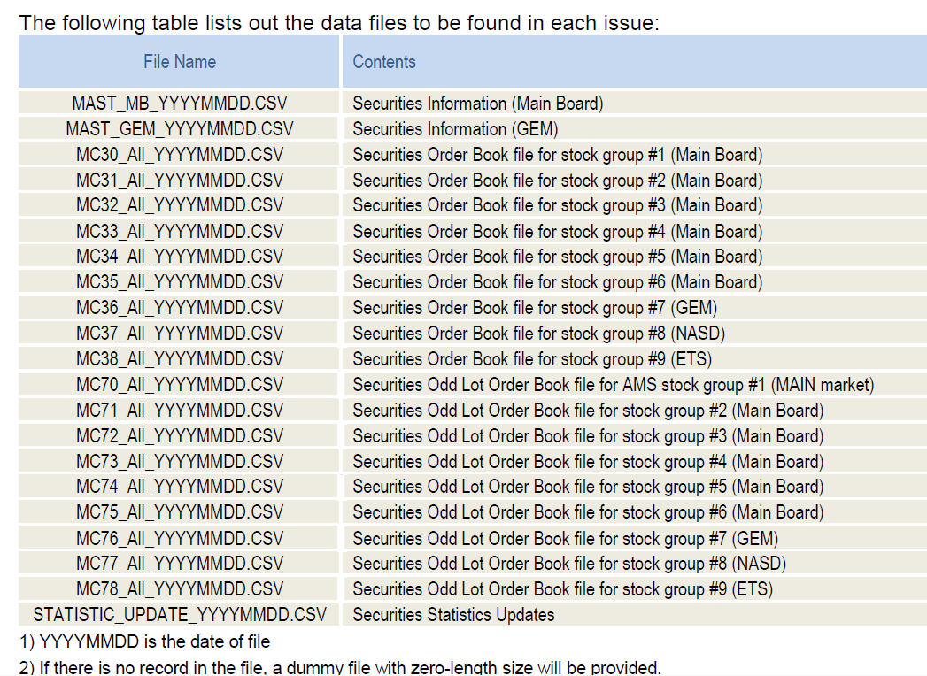
Raw Data – Historical Tick Data

Slide 32
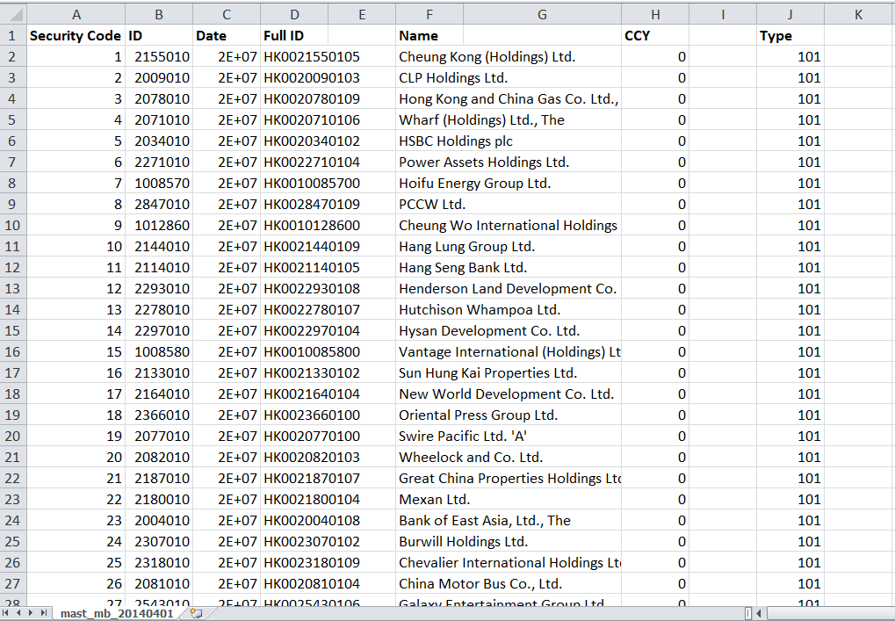
Raw Data – Historical Tick Data
Sample File: Security Information (Mainboard)

Slide 33
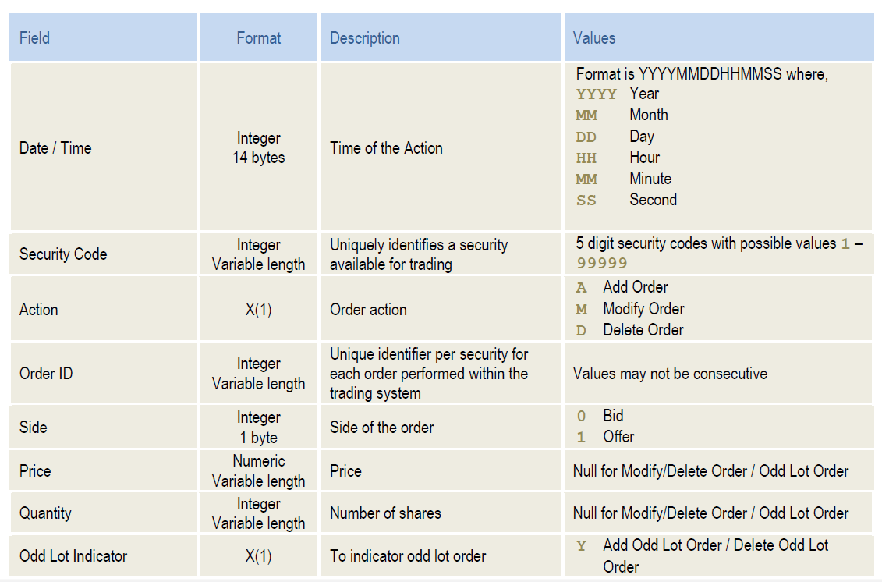
Raw Data – Historical Tick Data
Raw Tick Data Format

Slide 34
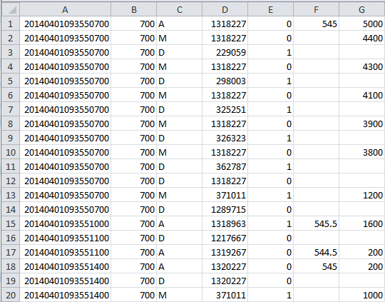
Raw Data – Historical Tick Data
Date/Time | Stock | Action | ID | Side | Price | Qty
Action (Order)
A: Add
M: Modify
D: Delete
Side
0 – Bid (Buy)
1 – Offer (Sell)
Sample File: 700.HK Raw Ticks

Slide 35
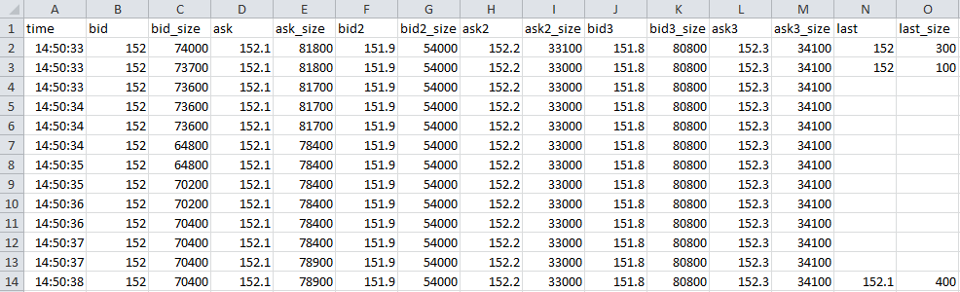
Processed Data – Order Book
Size | Bid | Ask | Size
74,000 | 152 | 152.1 | 81,800
54,000 | 151.9 | 152.2 | 33,100
80,800 | 151.8 | 152.3 | 34,100
Last Trade Price=152, Size=300
Sample File: 700.HK Order Book

Slide 36
Data Feature - Order Book Imbalance
Order Book Imbalance: the average ratio between the best bid and best ask size over a rolling 1-min window. If the average bid size is larger than the ask size (hence a positive ratio), like the example below, it indicates the price is more likely to go up. Vice versa, the price is more likely to go down.
1min-Order Book-Imbalance = Avg (Log(Best BidSize/ Best AskSize))
Options: We can take into account the first few levels (for example 3 levels) of the order book while the top level of the book will have higher weighting. The 1-min duration can also be customized to a shorter or longer duration.
Size | Bid | Ask | Size
100,000 | 9.5 | 9.6 | 20,000
40,000 | 9.4 | 9.7 | 350,000
200,000 | 9.3 | 9.8 | 80,000
Notes:
Ask why taking log – because the asymmetry of +ve and –ve ratio

Slide 37
Data Feature - Order Book Imbalance
Example (Assume the following order book numbers are 1-min average)
1min-Order Book-Imbalance = Avg (Log(Best BidSize/ Best AskSize))
First 1 Level: Log(100,000 / 20,000) = 1.609 ← Positive when Bid Size > Ask Size
First 2 Level: Log((100,000 + 40,000) / (20,000 + 350,000))
= Log(140,000 / 370,000) = -0.97 ← Negative when Ask Size > Bid Size
Size | Bid | Ask | Size
100,000 | 9.5 | 9.6 | 20,000
40,000 | 9.4 | 9.7 | 350,000
200,000 | 9.3 | 9.8 | 80,000
Notes:
Ask why taking log – because the asymmetry of +ve and –ve ratio

Slide 38
Data Feature - Money flow
Money flow: when a stock is purchased at a higher price (i.e. Last > Previous Last), it is called uptick and be considered positive money flow. When the next trade is at a lower price (a downtick), this is considered to be negative money flow.
If more shares were bought throughout the 5-min window on the uptick than the downtick, net money flow is positive because more investors were willing to pay a premium for the stock. If money flow is negative when a stock's price is rising, this could spell trouble.
5min-MoneyFlow = Σ( (Last – Previous Last) * Last Size)
Options: The 5-min duration can also be customized to a shorter or longer duration.

Slide 39
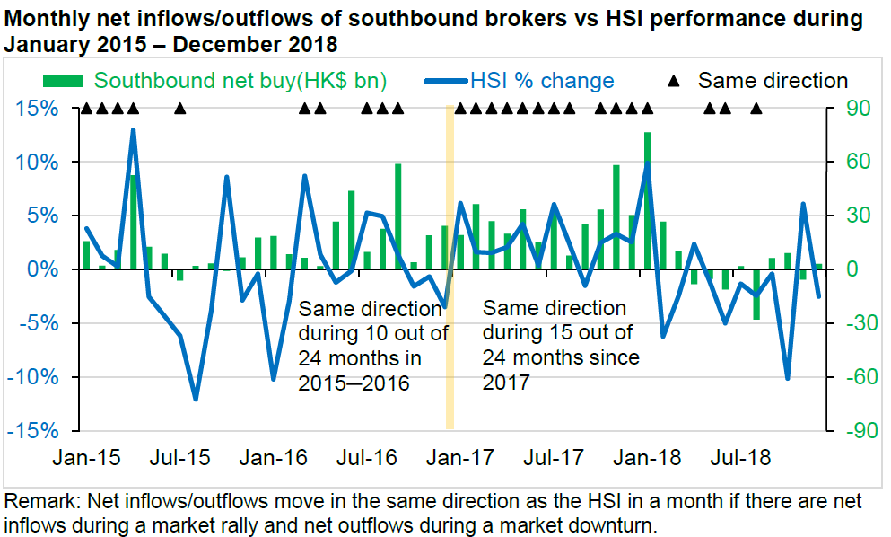
Data Feature - Money flow

Slide 40
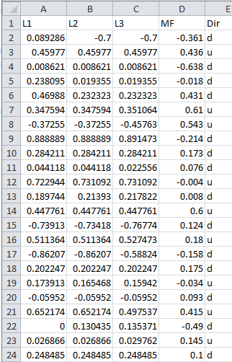
Training Dataset
Use Decision Tree to predict short-term stock (5.HK) movement (go up or down) from Order Book Imbalance (OBI) and Money Flow.
L1: First-1-Level OBI
L2: First-2-Level OBI
L3: First-3-Level OBI
MF: Money Flow
Dir: Mid-Price Direction - u(up) , d (down)
The data normalized to [-1, 1]
Why Data Normalization is necessary for Machine Learning models

Slide 41
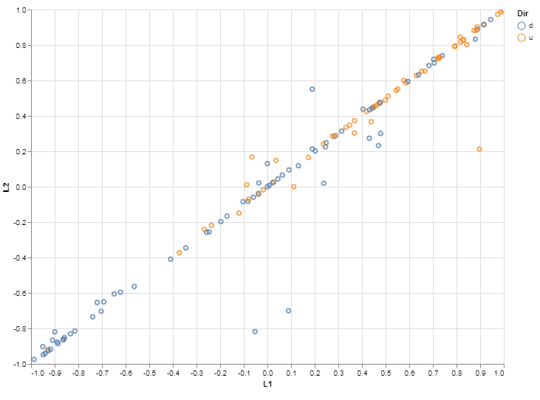
EDA (Exploratory Data Analysis)
Visualize the data: plotting Level-1 OBI and Level-2 OBI
Brown dots: stock going up, Blue dots: stock going down
More Brown dots (up) when both Level-1 and 2 OBI are positive and vice versa

Slide 42
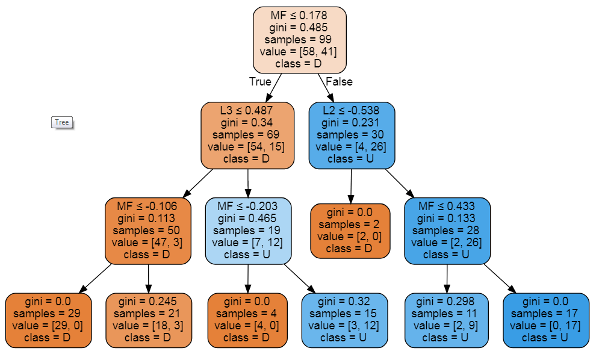
Decision Tree Algorithm
Decision Tree training results for this Stock (0005.HK) to be more likely to go up when:
Money Flow > 0.178 and First-2-Level OBI > -0.538 and Money Flow > 0.433

Slide 43
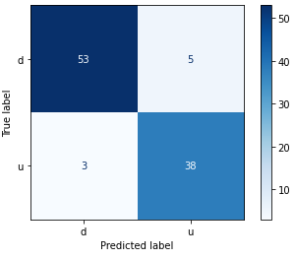
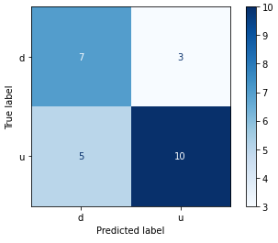
Performance Evaluation
Training
Testing
Training vs Test Accuracy
92% vs 68%
What’s that imply?
Any Improvement suggestions?
Code Example

Slide 44
Trained Model Usage
The “short term price prediction” alone probably cannot be a profitable strategy by itself. However, it can be a sub-module to improve certain aspect of other strategies
Trading Strategies – HK Warrant Follow the Super Trader
Enter Trade when "super user" trade (when a single trade of notation greater than certain amount on a warrant and ask price move up (>= 1 tick) within 10ms to 5s
Exit Trade in these 3 modes
1: Profit mode: Sell if bid + 2 ticks >= avg px
Improve Profit Mode: “Short Term Price Predictor” hints whether to wait a bit longer (Mid-Price Up) or shorter (Mid-Price down)

Slide 45

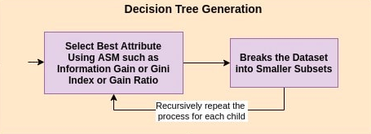
Decision Tree
ASM: Attribute Selection Measures

Slide 46

Support Vector Machine (SVM)
A classifier formally defined by a separating hyperplane.
The goal is to find the hyperplane that gives the largest minimum distance to the training examples. Therefore, the optimal separating hyperplane maximizes the margin of the training data (those data points in solid color that formed the maximum margin are the support vectors)
YouTube: SVM separate complex dataset

Slide 47

Support Vector Machine (SVM)
Nonlinear classification performed by applying kernel transformation
Transform to higher dimension space
(Notes: Statistical significance, Curse of Dimensionality)

Slide 48
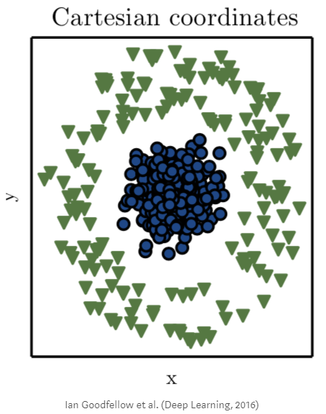
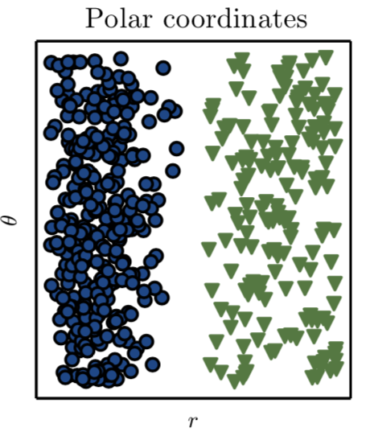
Support Vector Machine (SVM)
Nonlinear classification performed by applying kernel transformation
Transform to another co-ordinate space

Slide 49
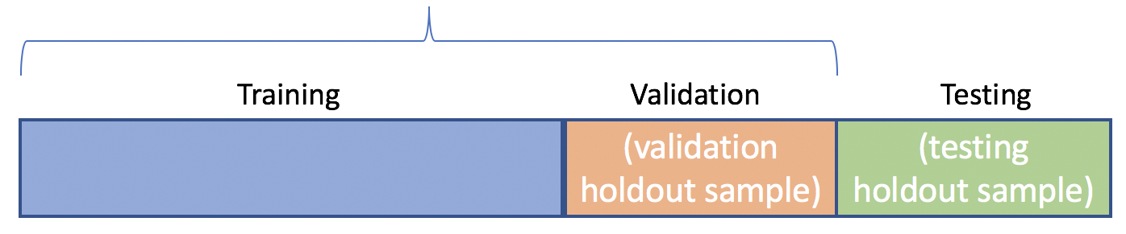
Dataset – Training, Validation and Testing
In-Sample
Training Set: the labelled data used to train the underlying model
Validation Set: set aside examples to tune the hyper-parameters
Test Set: the data set not seen by the model training and used only to assess the performance of a fully-trained model

Slide 50

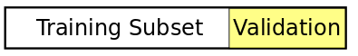
Dataset – Training, Validation and Testing
Validation Set
Holdout Validation: reserve certain % of the training data as validation set. Recommend for large data sets.
Cross Validation: partition the data set to n-fold. Trains a model using the out-of-fold observations. Assesses model performance using in-fold data and calculates the average test error. Recommend for small data sets.

Slide 51
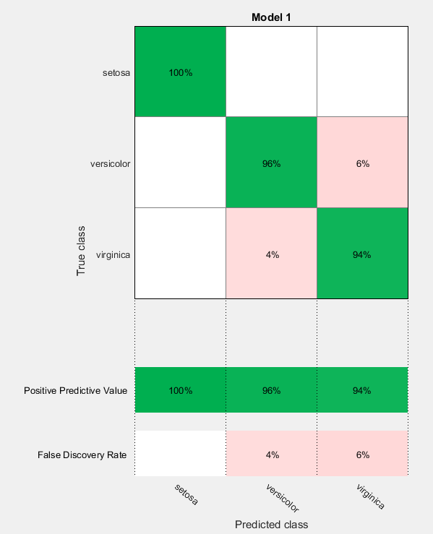
Performance - Confusion Matrix
False Positive: indicates a given condition exists, when it does not. Type I error where the test is checking a single condition, and wrongly gives an affirmative (positive) decision.
False Negative: that indicates that a condition does not hold, while in fact it does. Type II error occurring in a test where a single condition is checked for and the result of the test is erroneously that the condition is absent.

Slide 52
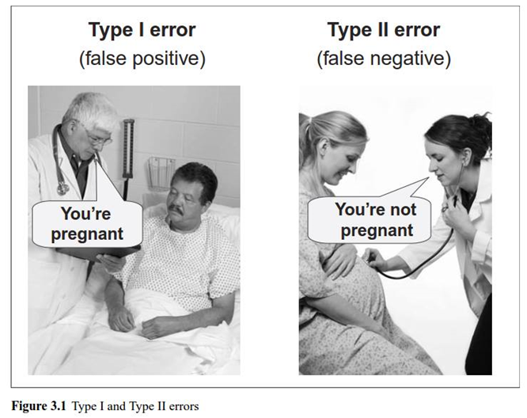
Performance – Type I & II Errors
Discussion
Production Support
Vs
Email Spam
How about Legal and Law?

Slide 53
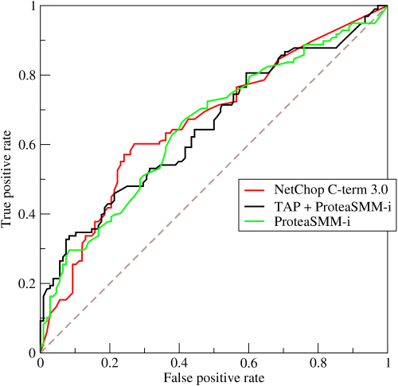
Performance - ROC curve
Receiver Operating Characteristic (ROC) curve: plots the true positive rate against the false positive rate at various threshold settings. The true-positive rate is also known as sensitivity, recall or probability of detection in machine learning. The false-positive rate is also known as the fall-out or probability of false alarm and can be calculated as (1 − specificity). The ROC curve is thus the sensitivity as a function of fall-out.

Slide 54

Performance - Accuracy
Accuracy vs Specificity
Example: Credit Card Fraud detection system (fraud is an anomaly event that happen only 1% in the dataset). If the system is able to predict Fraud or “No Fraud” in 99% accuracy, do you think it is good enough?
NO, a dumb system that always predict “No Fraud” will achieve 99% accuracy. Need to look specifically at the accuracy of the “No Fraud” cases (specificity).

Slide 55
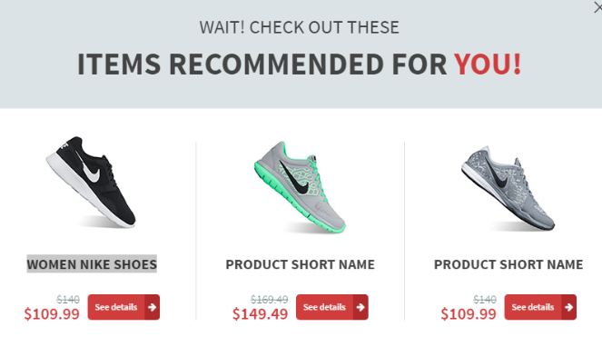
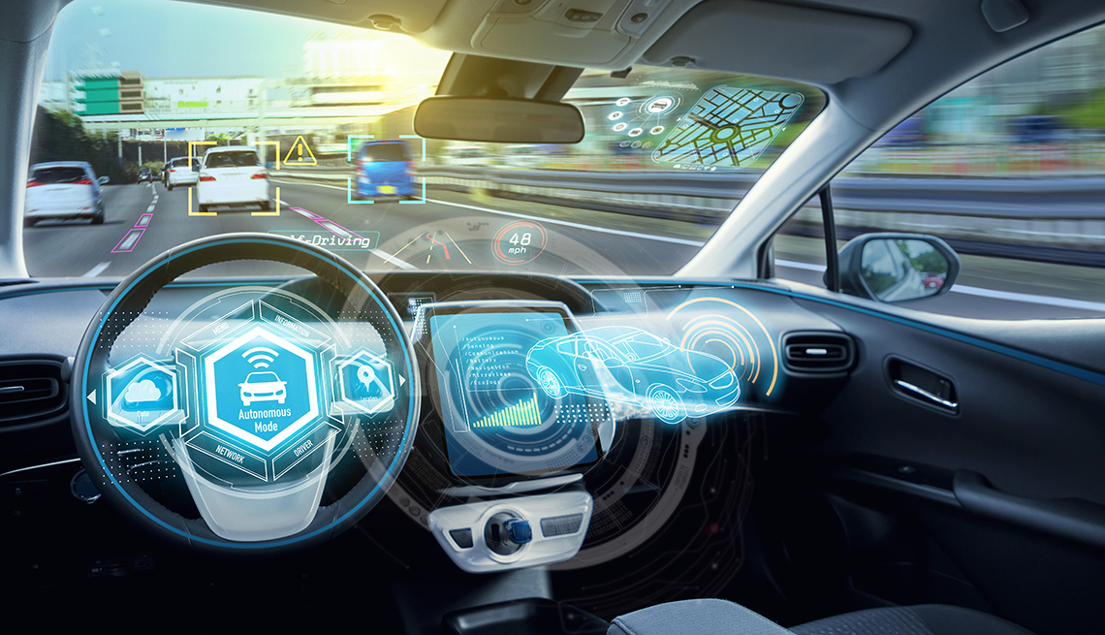
Performance - Accuracy
How much accuracy/specificity is enough: 70%, 80%, 90%, 99% ??
It depends on the applications. Self driving cars require much higher accuracy than the product recommendation system.
Trading and investment predictions are generally not very high in accuracy.

Slide 56
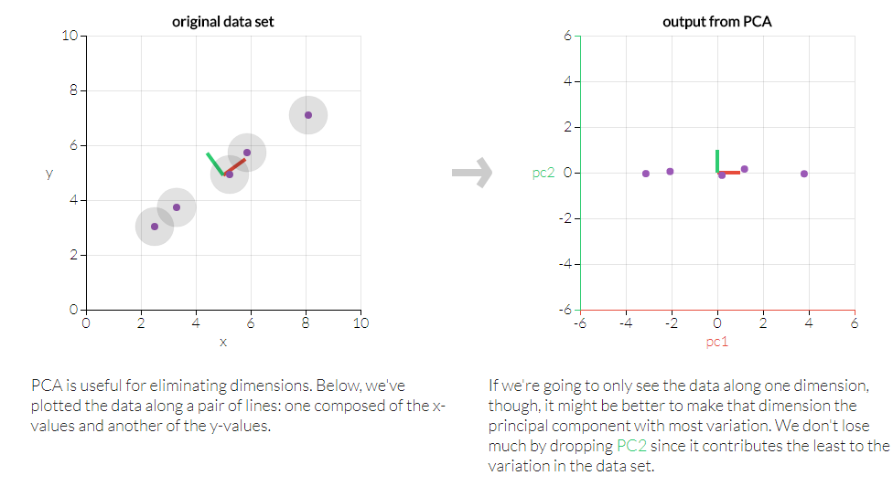
Unsupervised Learning - PCA
Principle Component Analysis: dimension reduction technique used to emphasize variation and bring out strong patterns in a dataset
(Example: Probably don’t need both HSI and tracker fund px to model market sentiment)

Slide 57
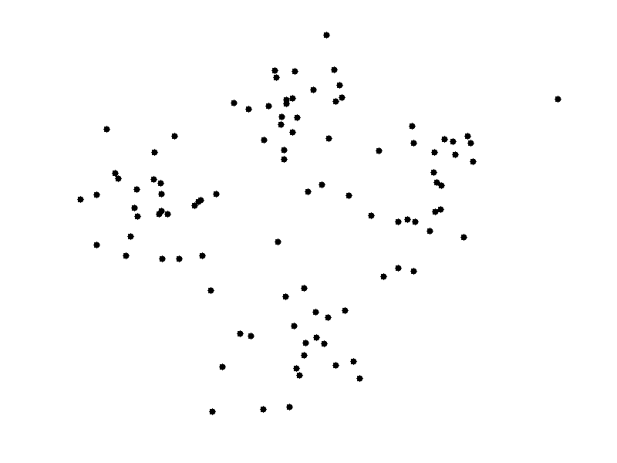
k-Means Clustering
k-means clustering: a type of unsupervised learning (unlabeled data).Find k groups in the data. The algorithm works iteratively to assign each data point to one of k groups based on the features that are provided. Data points are clustered based on feature similarity.
The centroids of the k clusters, which can be used to label new data
Labels for the training data (each data point is assigned to a single cluster)
Example: https://towardsdatascience.com/using-unsupervised-learning-to-plan-a-paris-vacation-geo-location-clustering-d0337b4210de

Slide 58


k-Means Clustering
Stocks Clustering: cluster the stocks in different groups by their underlying characteristics such as volatility and liquidity profile.

Slide 59
Machine Learning Workflow
Data Preparation: determine the input for the machine learning
Dataset: Collect, Clean and Normalize (e.g. scale the data into standard measure) the data
EDA (Exploratory Data Analysis): Visualize (e.g. scatter plot) the data to understand the key properties
Feature Selections: apply dimension reduction techniques (e.g. Principle Component Analysis or Factor Analysis) to see if the data (i.e. input features) can be reduced while maintain the similar predictive power.
(Note: Data collection and feature selection usually required in-depth domain knowledge to pick up the right dataset for training)

Slide 60

Machine Learning Workflow
Training and Prediction
Choose Algorithm
Train (Learn) the model from data
Tune hyper-parameters
Evaluate the accuracy
Used the trained model for prediction

Slide 61


Machine Learning Workflow

Slide 62

Deep Learning

Slide 63


Deep Learning - Example
Colorize Black & White Photos
http://demos.algorithmia.com/colorize-photos/
http://richzhang.github.io/colorization/
Cloud hosted deep learning models on Algorithmia. The Colorful Image Colorization microservice is a computer vision algorithm trained on a million images from the Imagenet dataset.

Slide 64

Deep Learning – Neural Networks
Connectionism inspired by the biological neural networks that constitute animal brains
Contrast this to Symbolic, Cognitive, Statistical and Evolutionary models (reasoning, generalization etc.)

Slide 65

Deep Learning – Neural Networks
ANN (Artificial Neural Network) consists of multiple layers (One Input/ Output and optionally multiple Hidden layers) of Neurons
The neurons are connected from one layer to another. It can be one direction forward (feed-forward), going backward (recurrent) or self connected (feed-back loop)

Slide 66


Deep Learning – Neural Networks
From the Input data, the network learn the weight parameters to fit the desired output
Activation functions (non-linearity) determine whether a particular neuron will be active (excitation) or not.

Slide 67

Deep Learning - Neural Networks
Back propagation: calculate the error contribution of each neuron after a batch of data. Used by the gradient descent optimization algorithm to adjust the weight of neurons by calculating the gradient of the loss function.

Slide 68

Visualize Neural Network

Slide 69


Visualize Neural Network

Slide 70

Deep Learning - Types
Long Short-Term Memory (LSTM) and Recurrent Neural Networks (RNN) are designed for sequence modeling.
They should be a good choice to model time series data

Slide 71

Deep Learning – CNN
CNN’s image representation at different layers is similar to how the brain processes visual information
Human sees structure/region (not pixel)
Use convolution in place of general matrix multiplication in at least one of their layers to learn the feature in a region

Slide 72


Deep Learning – CNN
Dense layers learn global patterns in their input feature space (MNIST-digit patterns involving all pixels), whereas convolution layers learn local patterns: in the case of images, patterns found in small 2D windows of the inputs (3 × 3 window size).
Learn spatial hierarchies of patterns. A first convolution layer will learn small local patterns such as edges, a second convolution layer will learn larger patterns made of the features of the first layers, and so on. This allows convnets to efficiently learn increasingly complex and abstract visual concepts (visual world is fundamentally spatially hierarchical).

Slide 73

Deep Learning – CNN

Slide 74

Deep Learning – LSTM
Code Example: LSTM – Bitcoin Time Series

